Slide 1
Objectives
Understand what is meant by cloud storage
Explain the advantages and disadvantages of storing data on the cloud in comparison to storing it locally

Slide 2
Exam Questions
1. Desmond is buying a new computer for editing photos and videos. A friend says that he will need a large amount of primary and secondary storage.
(a) Define what is meant by main memory. [1]
Short term / volatile storage of data (when RAM). (1) Memory directly accessible by the CPU. (1)

Slide 3
Exam Questions
(b) Define what is meant by secondary storage. [1]
Long term / non-volatile storage of data. (1) External memory / auxiliary storage. (1) Memory not directly accessible by CPU. (1)

Slide 4
Exam Questions
(c) Two technologies that can be used to store data in a laptop computer are magnetic hard disk drives or a solid state drives.
State one other technology that can be used to store data. [1]
Optical (drives) (1)

Slide 5
Exam Questions
Desmond is deciding whether to get a magnetic hard disk drive or a solid state drive for his computer.
Explain two advantages of a solid state drive. [2]
Reading data will be faster. (1) There is no need to wait for the drive head to go to the correct track / wait for the drive to spin to the correct sector. (1) The drive will be more robust/durable/likely to work after being dropped. (1)
Accept the drive being lighter/smaller.

Slide 6
Exam Questions
(e) The solid state drive makes use of memory cells. Each memory cell has both a control gate and a floating gate.
(i) Describe how a floating gate is used to store one bit of data. [2]
The floating gate stores data by trapping electrons inside it (1). This allows current to flow or not flow depending whether the electrons are trapped (1). If electrons are trapped a 0 is stored in the cell / if no electrons are trapped a 1 is stored in the cell (1).

Slide 7
Exam Questions
(ii) Describe how control gates are used to write a 1 to the memory cell. [2]
A negative voltage is applied to the control gate (1) causing the electrons to be able to travel through the isolation layer (1). This results in no electrons in the floating layer (1). When no electrons are located in the floating gate the current is able to flow (from source to drain), which indicates that a 1 is stored in the memory cell (1).

Slide 8
Exam Questions
(f) Desmond has decided to purchase an external optical storage device. He would rather have a Blu-ray drive rather than a DVD drive.The DVD drive makes use of a red laser whilst the Blu-ray drive makes use of a violet laser.
State the difference that using a violet laser makes in a Blu-ray drive. [1]
The wavelength is smaller / meaning that more data may be stored on the disk. (1)

Slide 9


Starter
Many people and companies now use the cloud
What is the cloud?

Slide 10

The cloud
The cloud is another name for services offered via the Internet
The name comes from network diagrams that use a cloud symbol to represent the Internet
The cloud can be split into two major areas:
Cloud storage
Cloud computing
What is cloud storage?

Slide 11

Cloud storage
Cloud storage allows users to store files and data on the Internet
The files are accessed remotely by users
Data may be stored in multiple locations
A professional company will manage the data storage
What are two other cloud storage features?

Slide 12
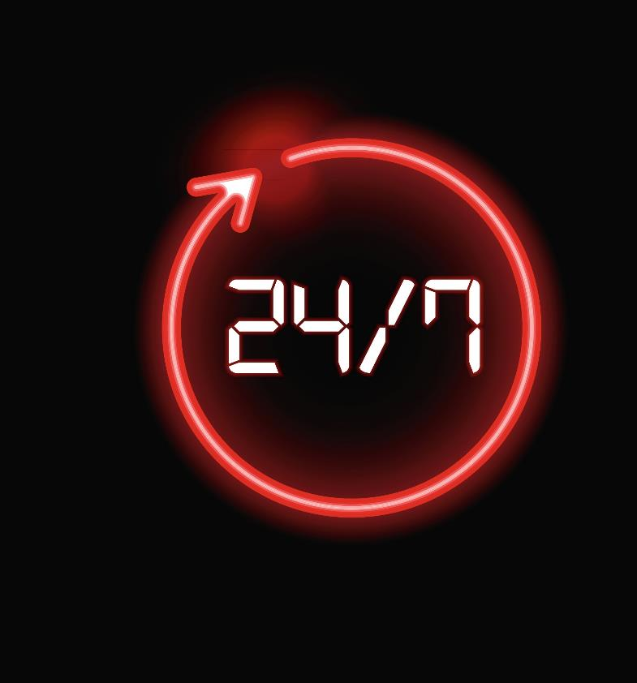
Cloud storage features
Further features include:
Synchronisation of devices with the cloud storage
24/7 Availability
Redundancy
Multiple file versions
Only pay for storage used
Scalability
What do each of these features mean?

Slide 13

Redundancy
Storage redundancy is where multiple copies of files are stored in different locations
In local storage this is normally carried out by having multiple copies of files on two different hard drives in one server
In cloud storage the locations that store redundant files may be anywhere in the world

Slide 14

Scalability
Scalability is the ability of the storage system or cloud computing resources to increase in size
A home PC doesn’t have scalable storage. It may be possible to have two or three hard disks, but not two or three hundred
Cloud storage normally charges for the amount of storage used
Increasing offline storage usually requires the purchase of new disks

Slide 15
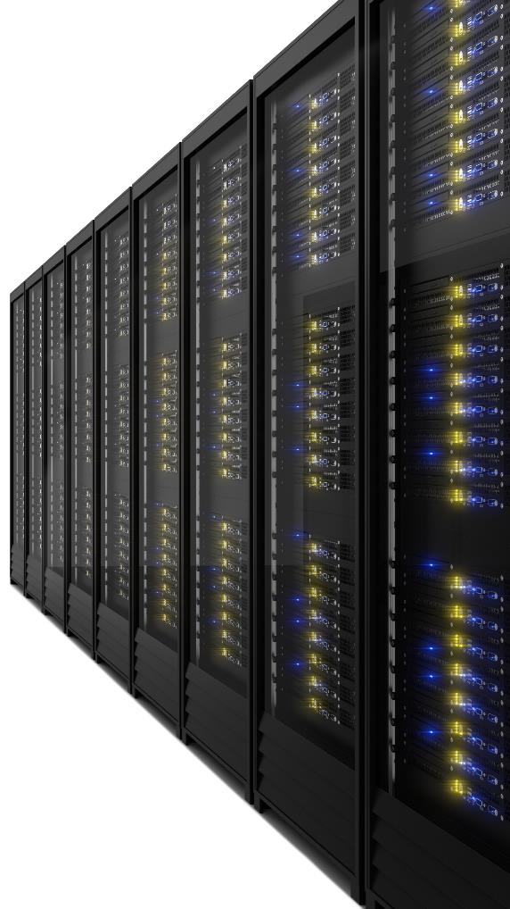
Data centres
Data centres are buildings that are dedicated to storing physical servers
Each server will contain an array of hard drives
Professional engineers will manage the computers
The buildings will have temperature control and air conditioning
Uptimes for data centres are often better than 99.99%

Slide 16
Worksheet 6
Complete Task 1 and Task 2 on Worksheet 6

Slide 17

Privacy
If data is stored in the cloud, the security and privacy of the data is controlled by an external company
Data stored locally is under the control of a single person or organisation
Both cloud storage and local storage may be hacked, however, typically cloud storage will be more secure
Companies and organisations will need to consider the level they trust an external company to hold their data

Slide 18
Data transfer speeds
When a file is used that is on cloud storage it must first be downloaded
With a fast connection and a small office document this may happen in a few seconds
However, with files such as those used in video editing it may take hours to open or save files to cloud storage
Local storage is very fast to transfer data
A local SATA solid state drive can read and write data at around 500 MB per second
A typical UK internet connection operates at around 70 Mb/s giving speeds of less than 10 MB per second

Slide 19
Worksheet 6
Complete Task 3 on Worksheet 6

Slide 20

Plenary
Work in a pair to answer the following questions:
What is cloud storage?
How does it differ from local storage?
What are two advantages and disadvantages of cloud storage compared to local storage?

Slide 21
Plenary
What is cloud storage? Remote storage provided by a company that is bought as a service
How does it differ from local storage? Local storage consists of hard drives that are owned and maintained by the user or organisation themselves
What are two advantages and disadvantages of cloud storage compared to local storage? Some suggestions:
Cloud storage advantages | Cloud storage disadvantages
Redundancy in many remote locations | Takes longer to download data in the case of a full restore
Managed by the cloud storage provider | Not appropriate for large files where quick access is needed

